Slide 1
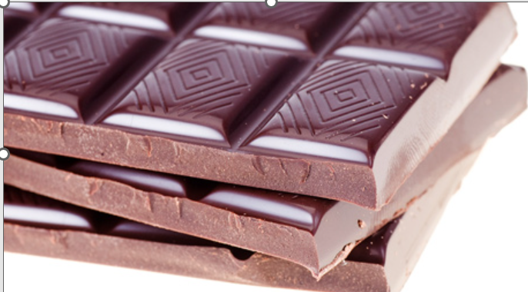
Final Project Chocolate Rating
By Anh Huynh

Slide 2
Table of Contents
1
Introduction
Goals
2
DATA description
DATA Cleaning & EDA
3
Database & MySQL
Insights
4
Deploy Machine Learning

Slide 3
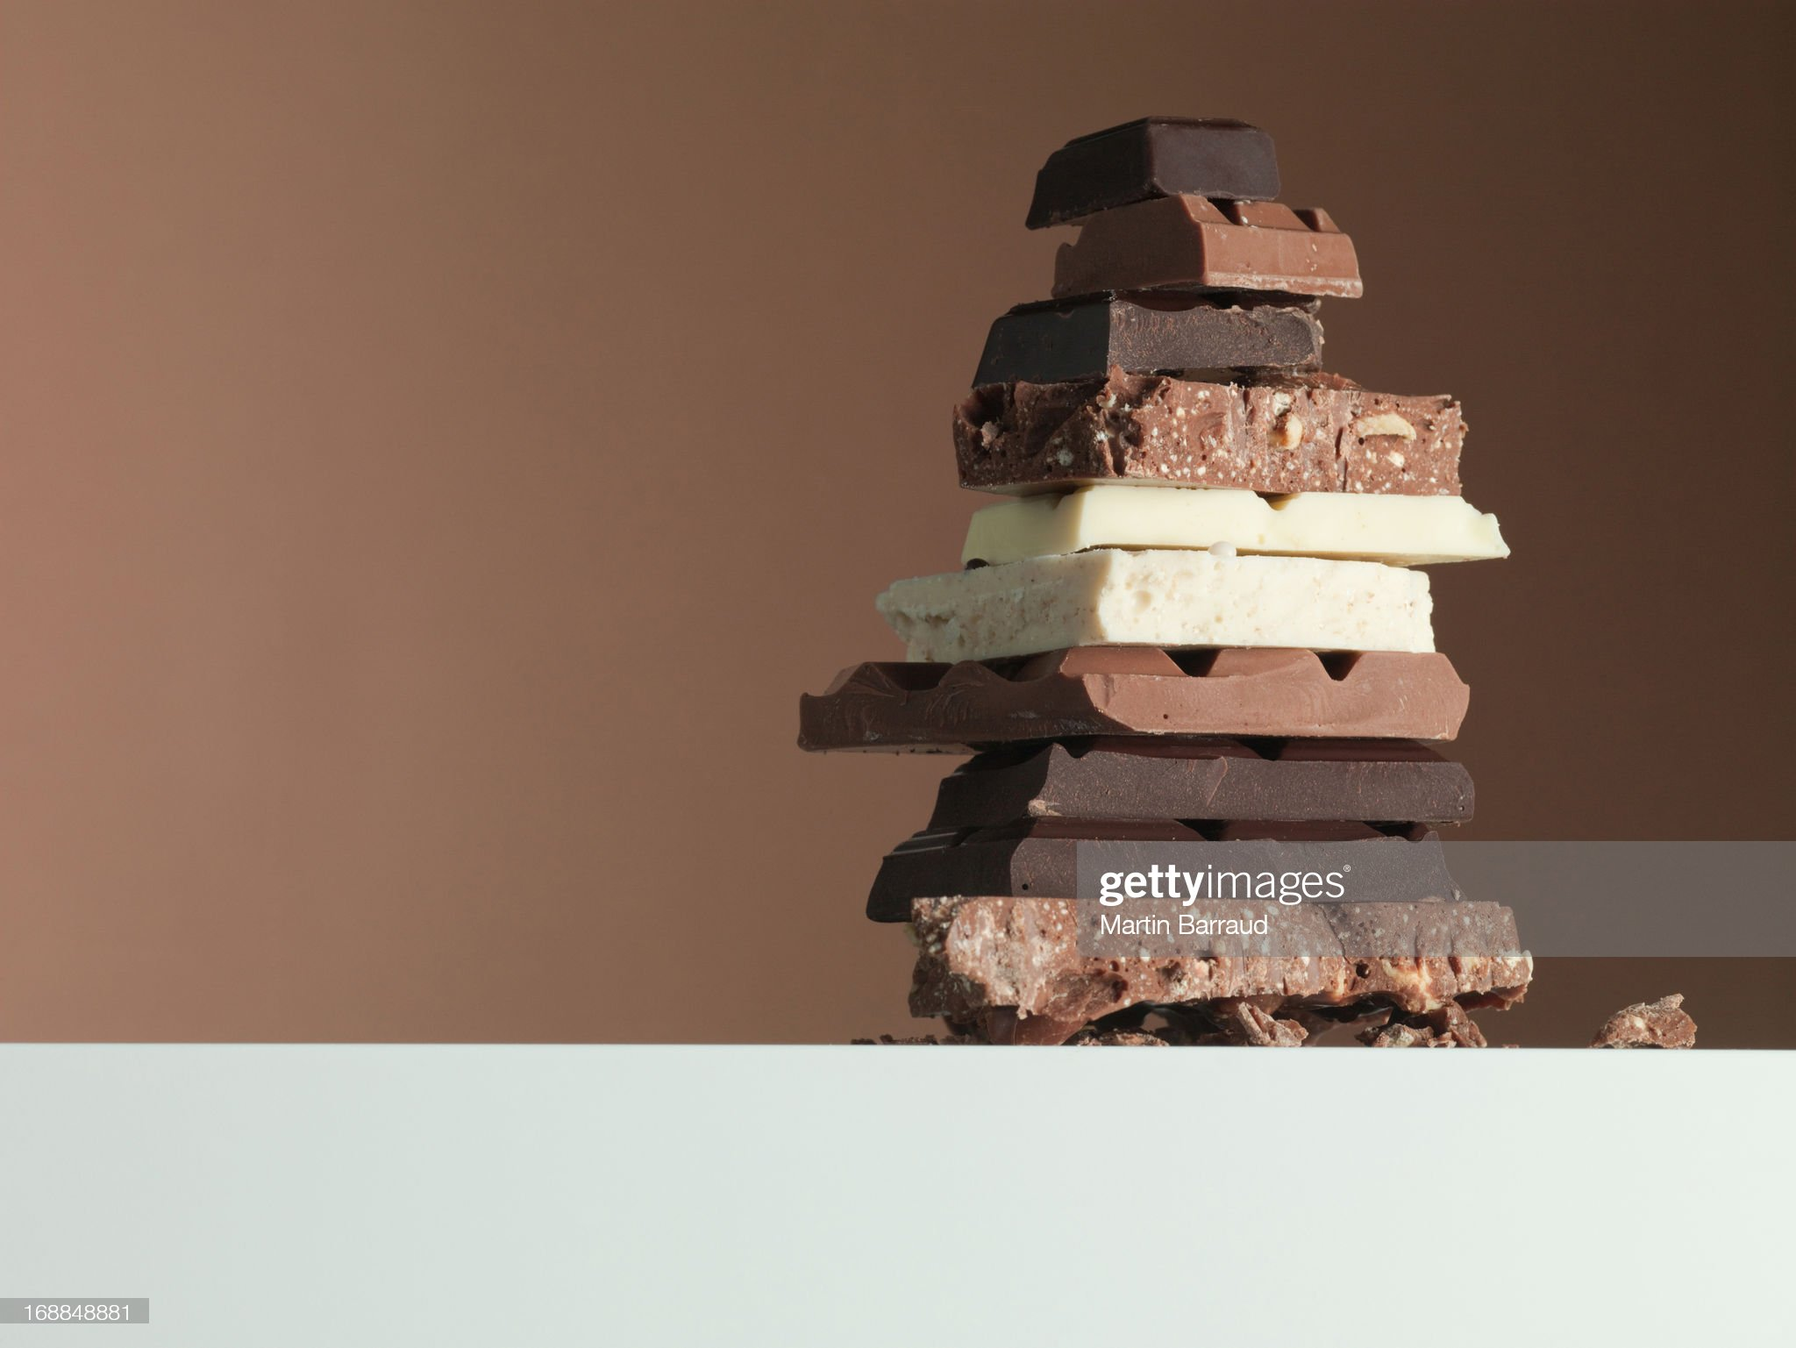
Overview
The cacao tree was cultivated more than 3000 years ago by the Maya, Toltec and Aztec
They use cocoa bean to prepare a beverage as a ceremonial as a currency.
The Maya considered chocolate to be the food of gods, held the cacao tree to be sacred for after life
Today chocolate industry estimated to be an USD 130.56 billion-dollar industry
CHOCOLATE RATING

Slide 4
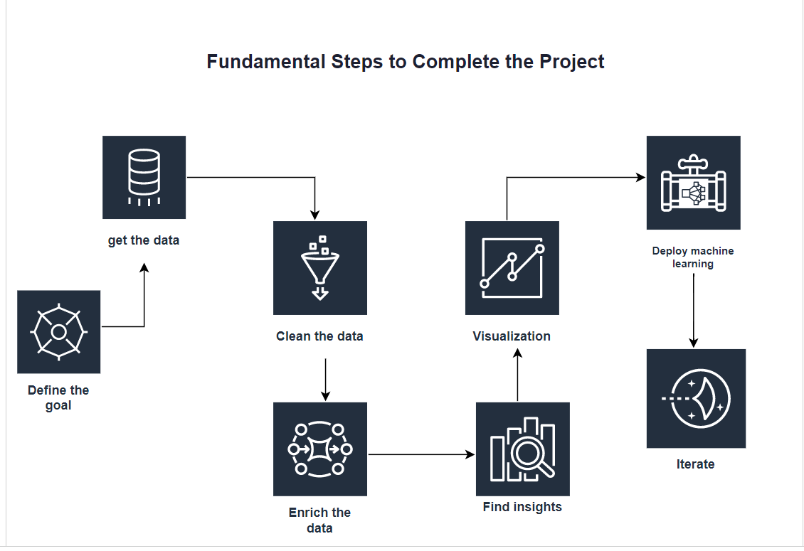
Project Main goals
Main dataset ‘Chocolate rating | 2530 rows,10 columns
Chocolate flavor | 1795 rows × 9 columns
Countries and continents | 249 rows × 9 columns

Slide 5
Data Descriptions Ingredients Rating
B (Beans)
S* (Beet sugar)
S (Sugar)
C (Cocoa Butter)
V (Vanilla)
Sa (Salt)
(L) Lecithin
3.5 - 4 = Outstanding
3.0 - 3.49 = Recommended
2.0 - 2.9 = Disappointing
1.0 - 1.9 = Unpleasant

Slide 6
Data Descriptions
Compagnie
(manufacturers)
Company location
Country of bean origin
Cocoa percent
Review day

Slide 7
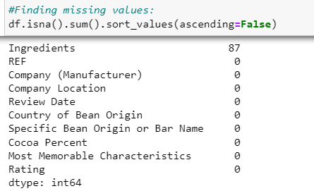
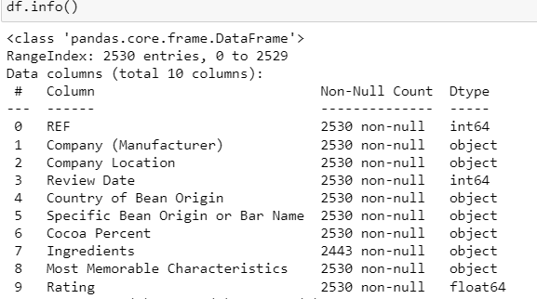
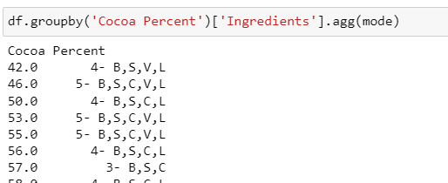
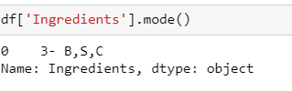
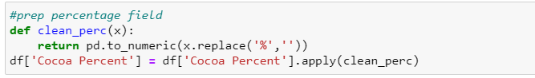

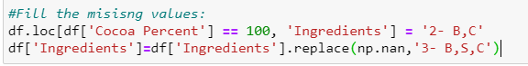
Data cleaning (Main data)

Slide 8
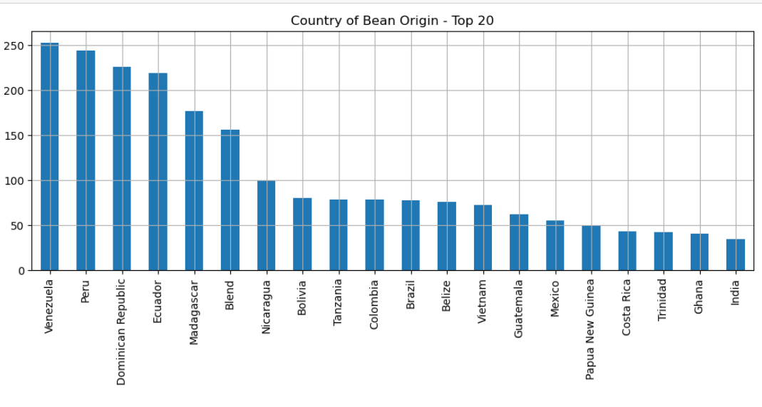
EDA

Slide 9
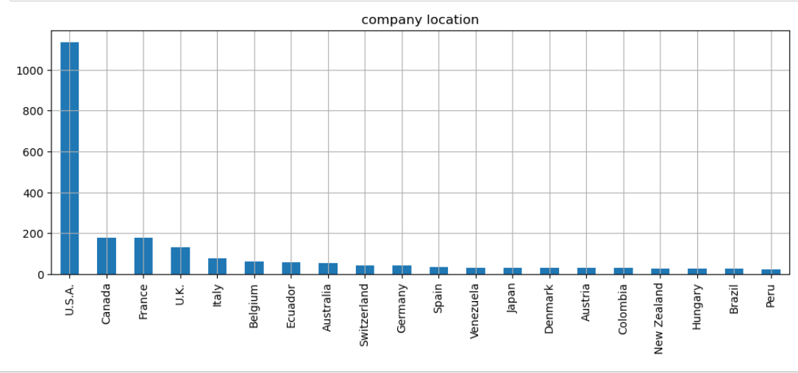
Company location

Slide 10
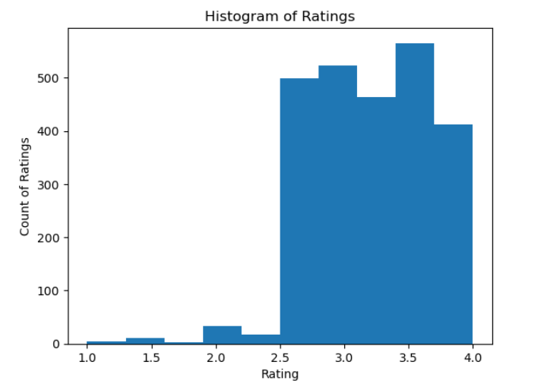
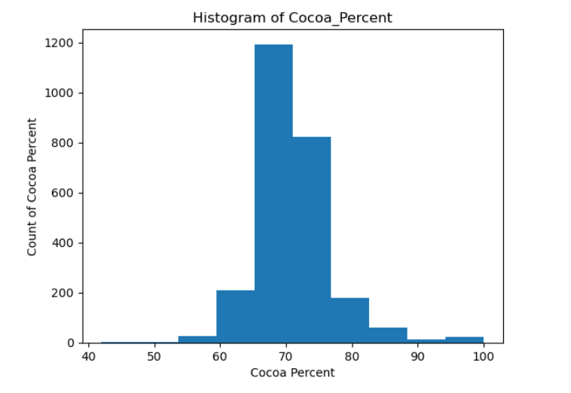

Slide 11
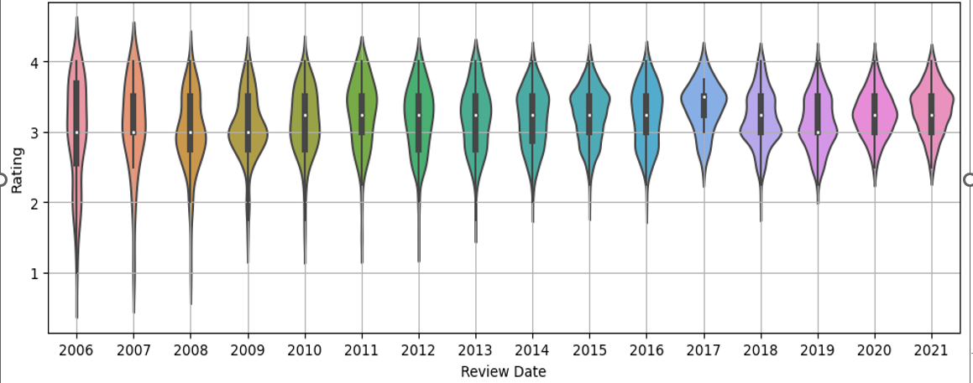
Rating by Year

Slide 12
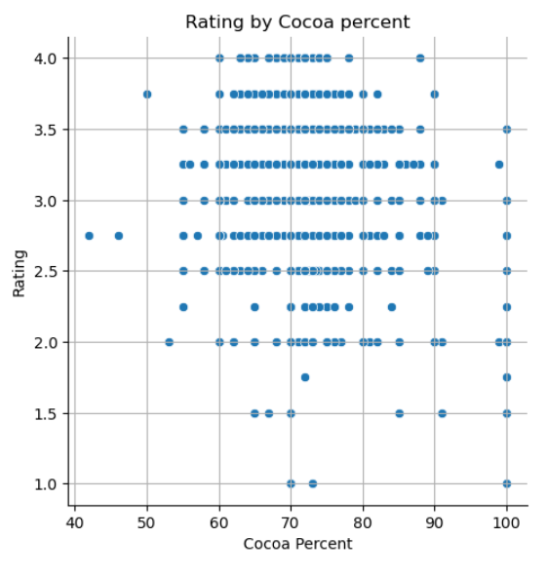
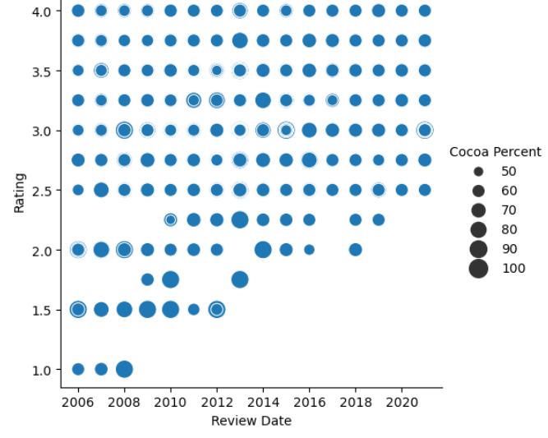
Rating by cocoa percent

Slide 13
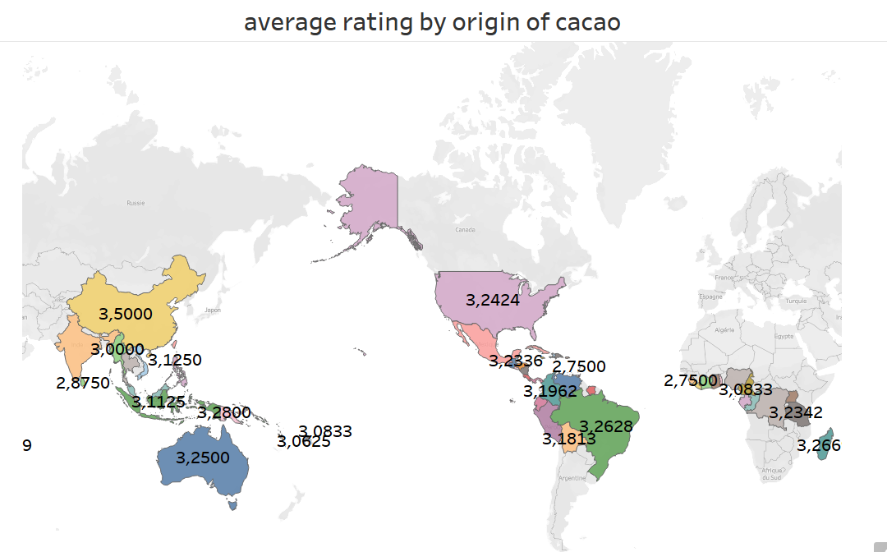

Slide 14
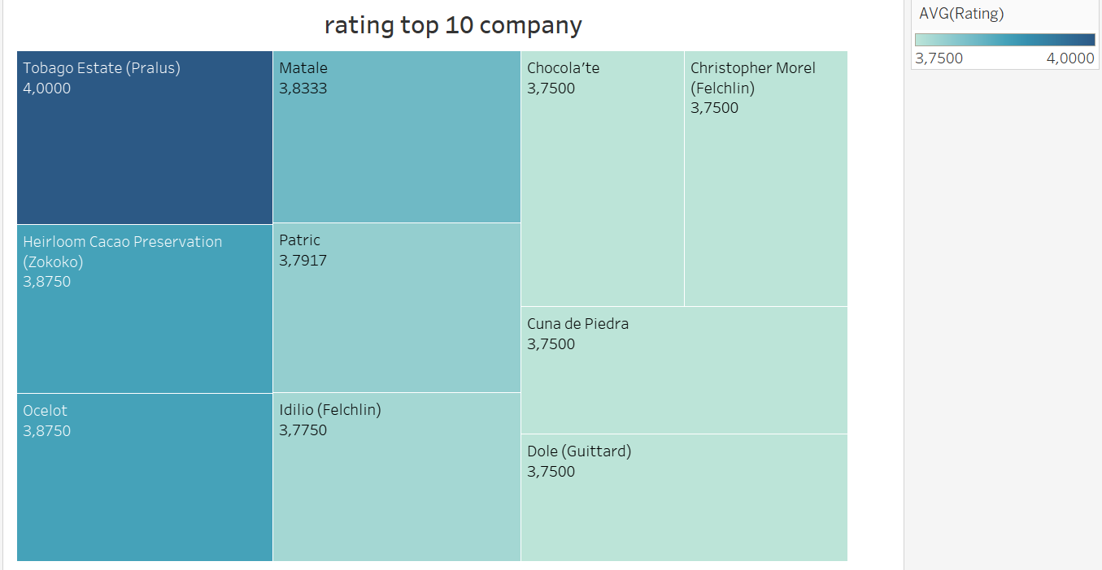

Slide 15
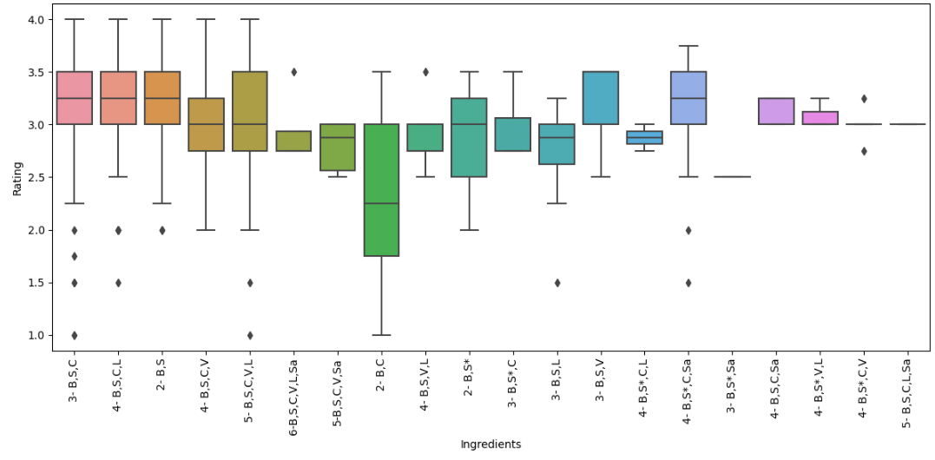
Rating by ingredients

Slide 16
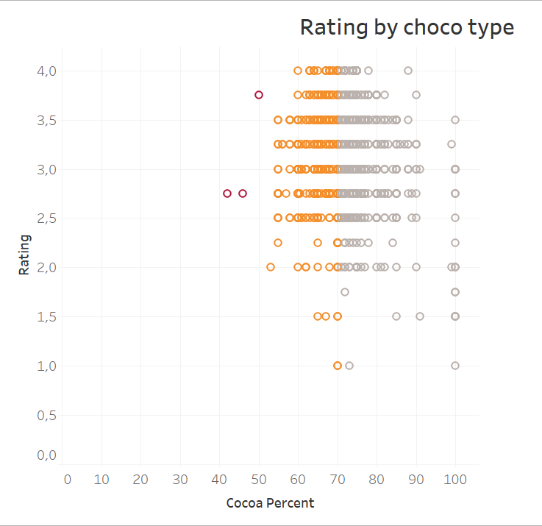
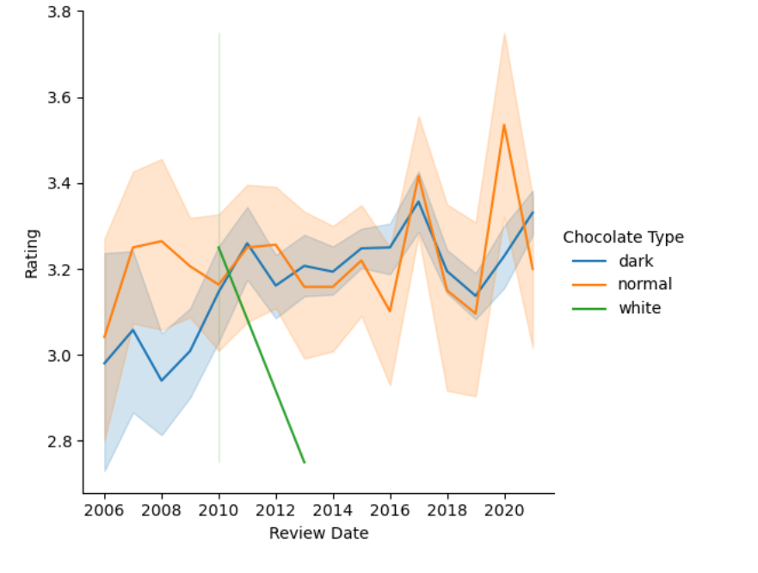
Further exploratory data analysis Rating by chocolate type

Slide 17
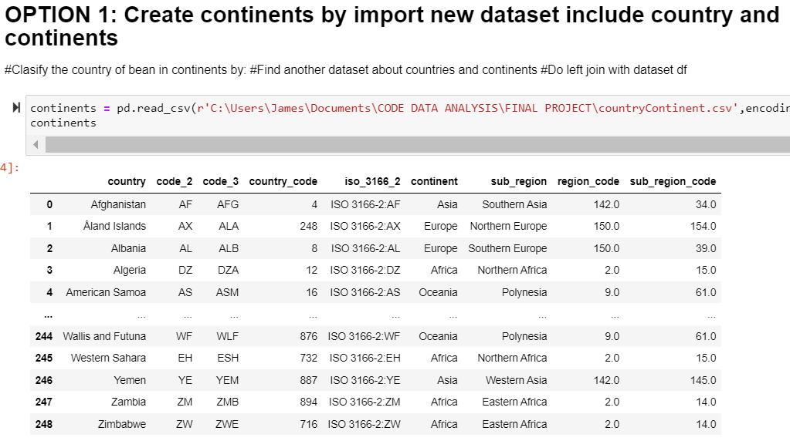
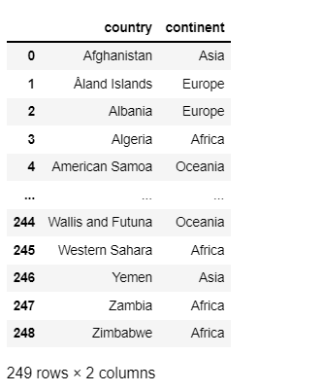
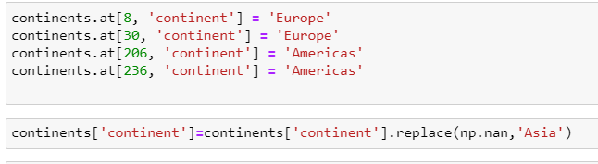

Slide 18
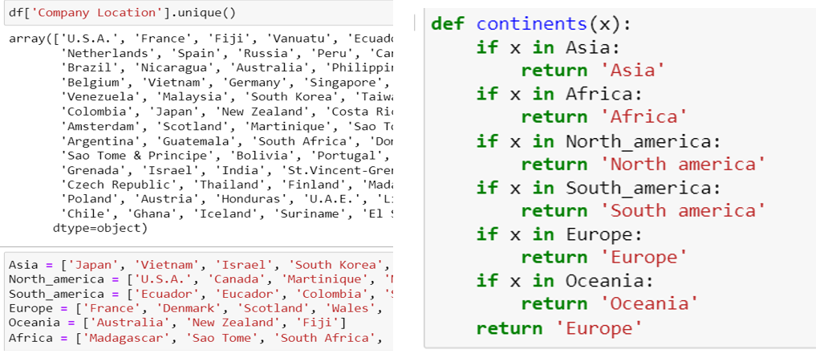
Option 2

Slide 19
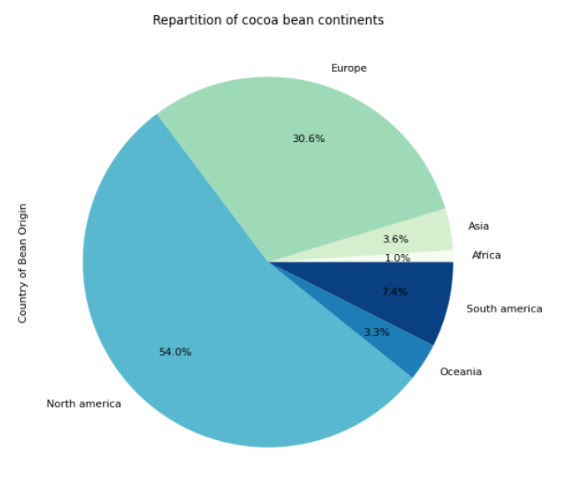

Slide 20
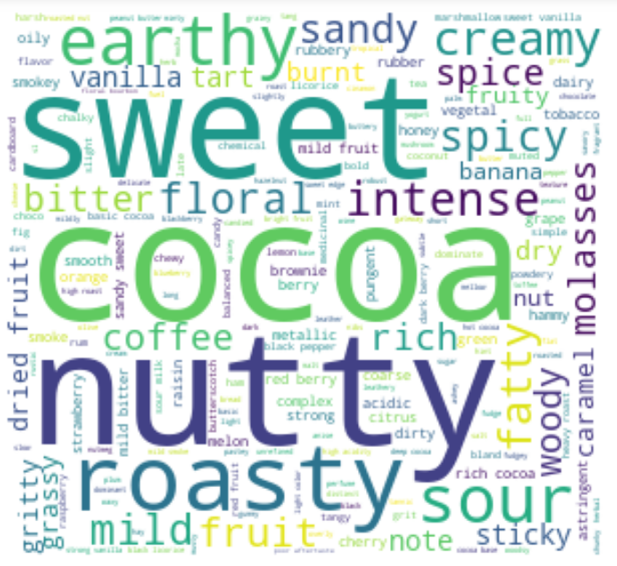
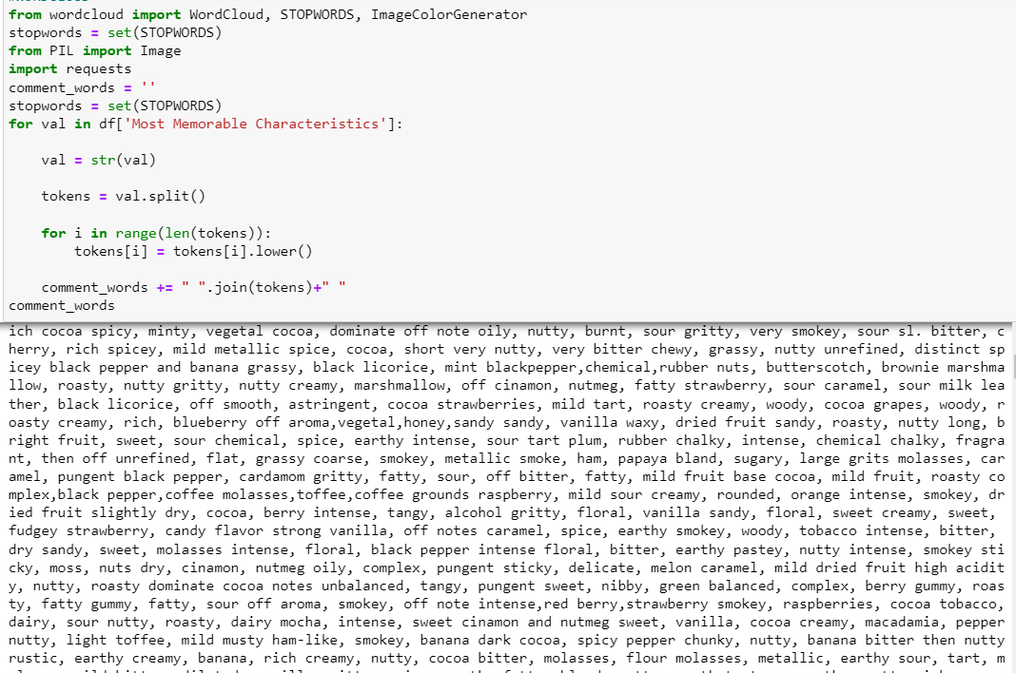
Wordcloud

Slide 21
Database type comparation
SQL | NoSQL
Relational Use structured query language and predefined schema Can work with smaller amount of data Are table-based, multi-row transaction OOP unfriendly (object-oriented programing) | Non-relational Have dynamic schemas for unstructured or semi structured data Can work with big amount of data Document key-value, graph, wide-column OOP friendly

Slide 22
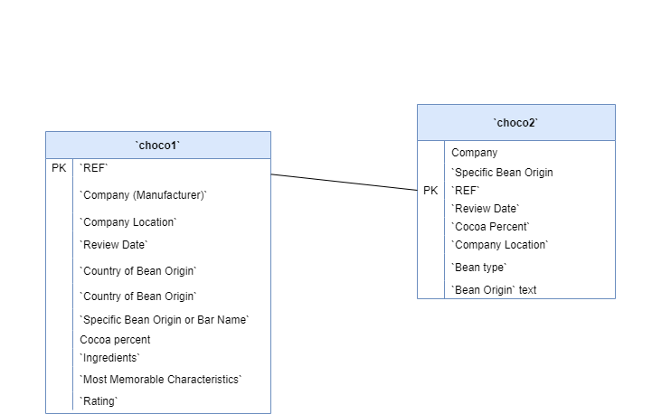
Entities. ERD

Slide 23
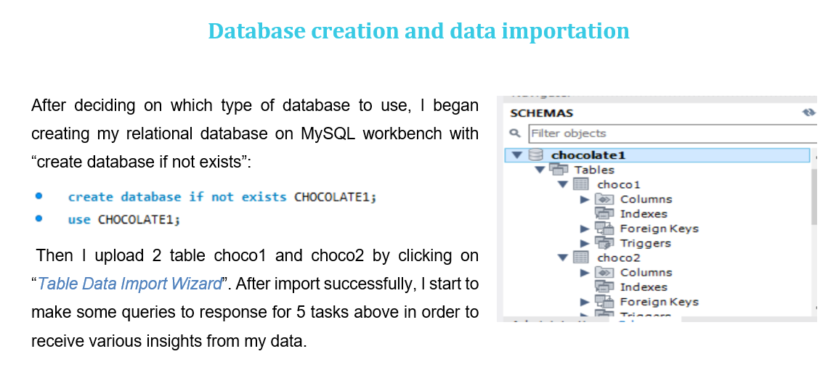
MySQL

Slide 24
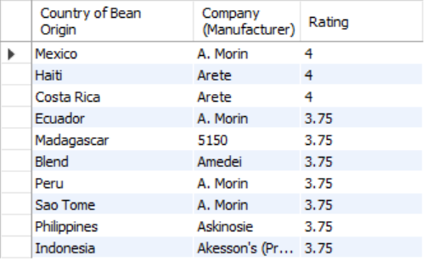

Slide 25
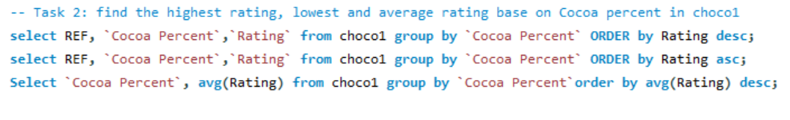
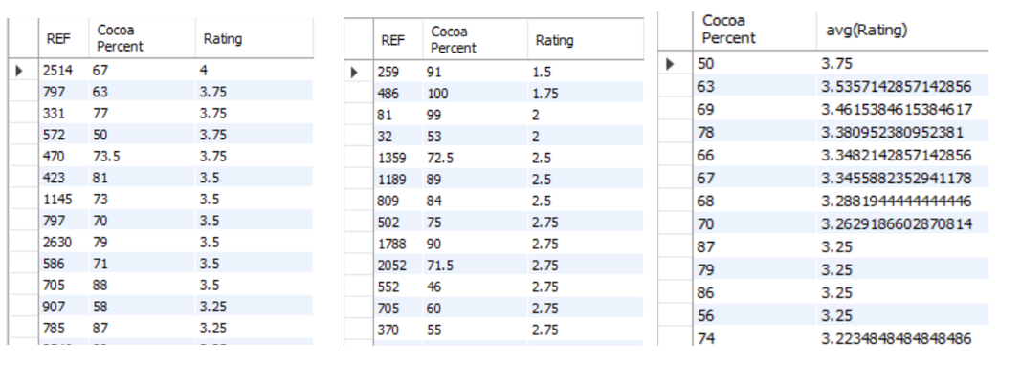

Slide 26
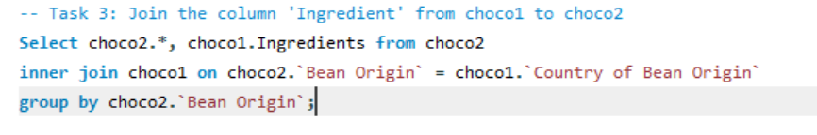
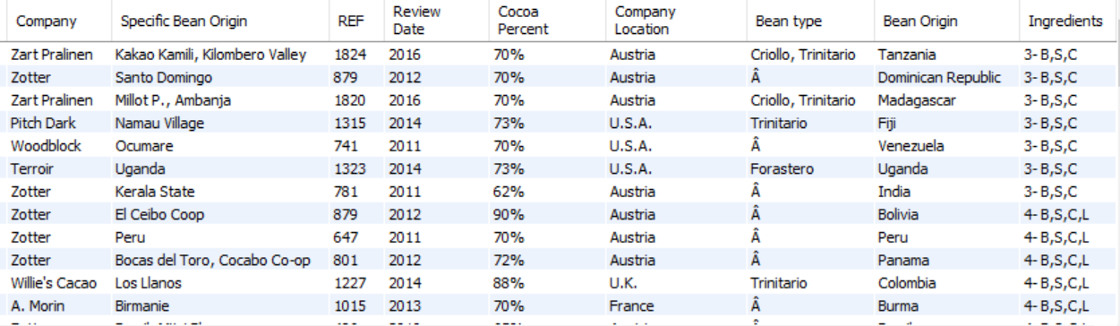

Slide 27
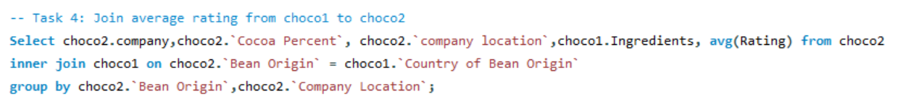
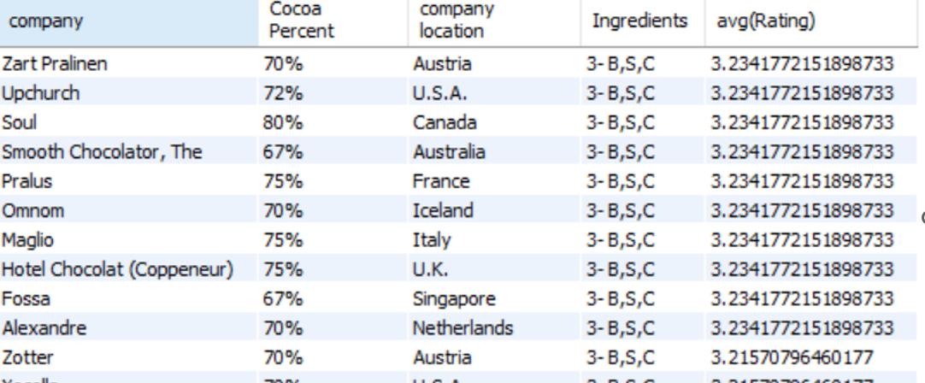

Slide 28
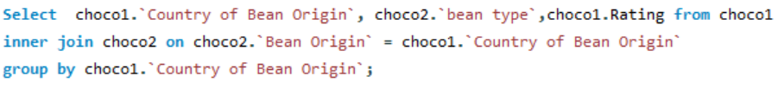
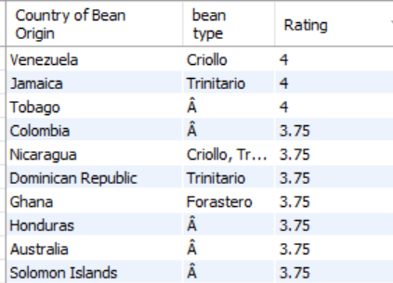
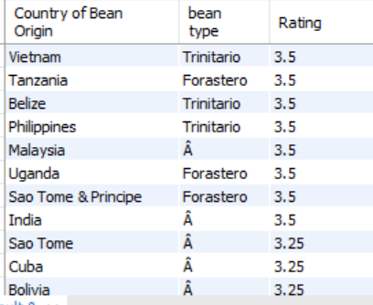

Slide 29
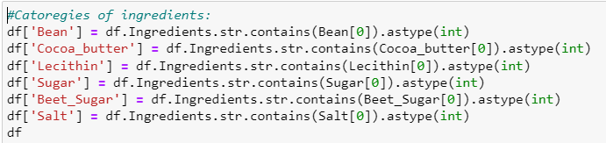
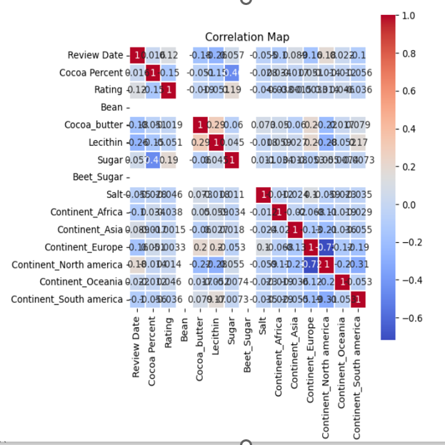

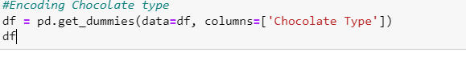
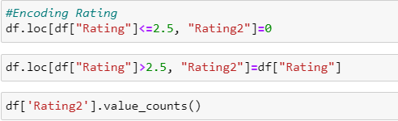
Encoding_data preparation

Slide 30
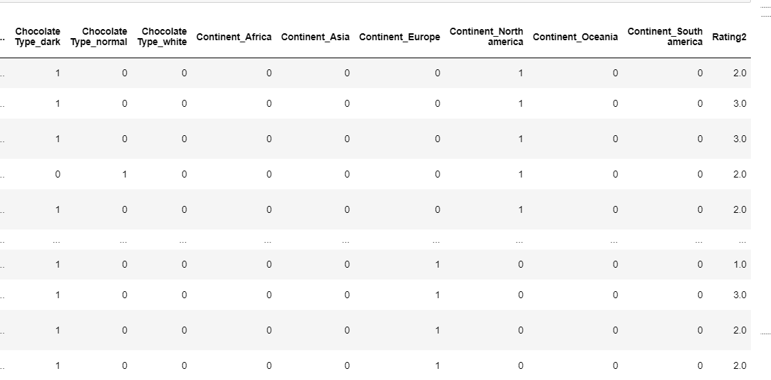

Slide 31
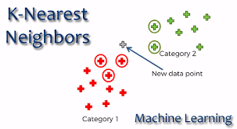


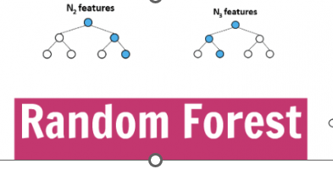
Deploy Machine learning

Slide 32

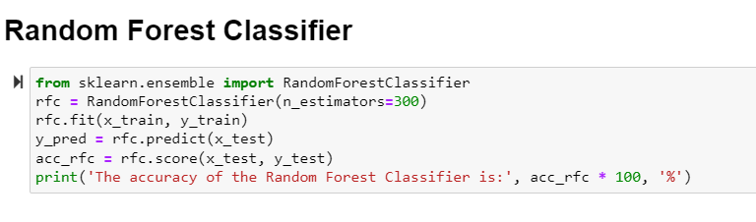

73%
66%
74%

Slide 33
Conclusion
Consumers prefer chocolate from 65-75% cocoa
Chocolate brands can affect to the choices of customers
From review time, It show the quality of chocolate are improving
The biggest production of chocolate is in USA
Predict how well a chocolate bar will do in the near future to see if we can increase sales

Slide 34
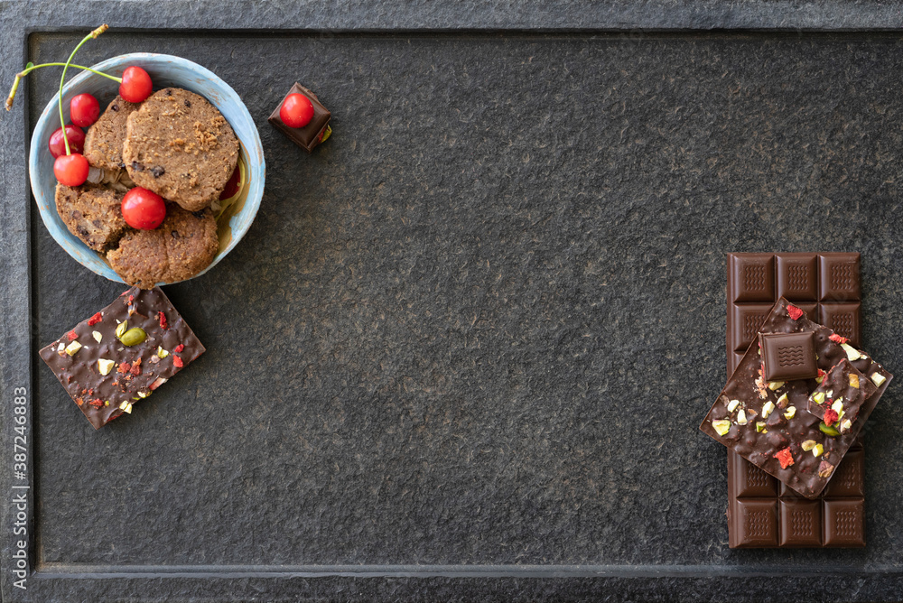
Q &A
Thank you

